Slide 1


An Introduction to MNE-BIDS and MNE-Python
Tao Xia
Social Cognitive & Neuroscience Lab
Department of Psychology, The University of Hong Kong
Nov 22, 2020

Slide 2

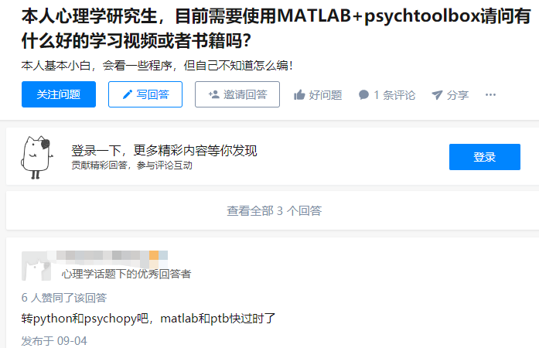
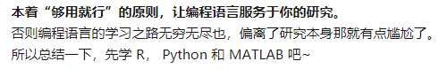
Why Python?

Slide 3






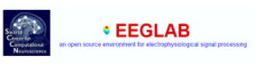



Why Python?

Slide 4
Why Python?
Recommendation stack of Python tools for EEG Analysis
Tool Name | Developers | Description
PsychoPy | Peirce et al. | A software used to run psychology and neuroscience experiment
MNE-BIDS | Appelhoff et al. | A Python package that allows you to read and write BIDS-compatible datasets with the help of MNE-Python
MNE-Python | Gramfort et al. | Open-source Python package for exploring, visualizing, and analyzing human neurophysiological data: MEG, EEG, sEEG, ECoG, NIRS, and more.
NeuroRA | Zitong Lu | A Python Toolbox for Multimode Neural Data Representation Analysis
scikit-learn | Pedregosa et al. | A Python package for Machine Learning
Matplotlib/Seaborn | Hunter et al./Michael et al. | Data visualization library based on Python

Slide 5
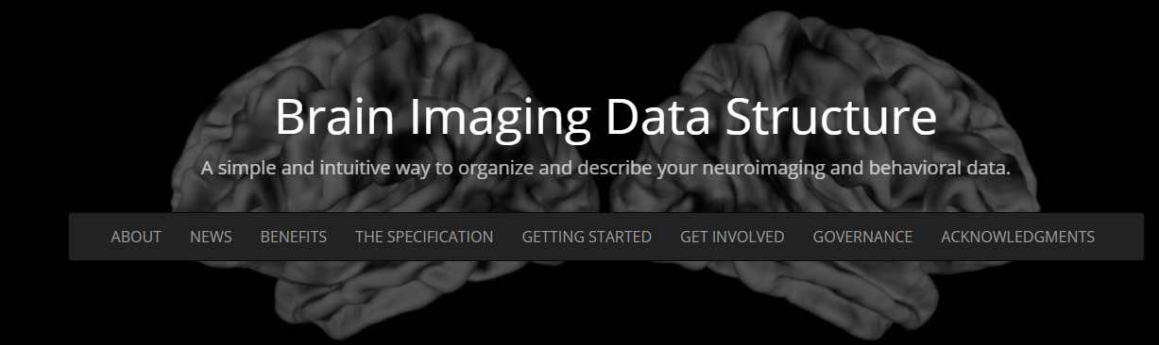
What is BIDS and Why do we need it?
BIDS, the Brain Imaging Data Structure, is a standard that describes how to organize neuroimaging and electrophysiological data. In particular, it defines:
which file formats to use
how to name your files
where to place your files within a directory structure
what additional metadata to store

Slide 6
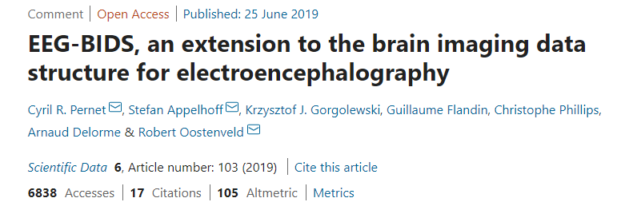
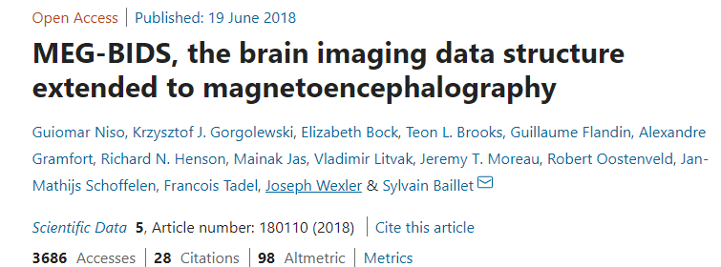
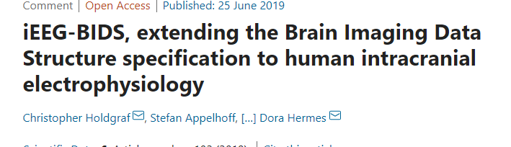
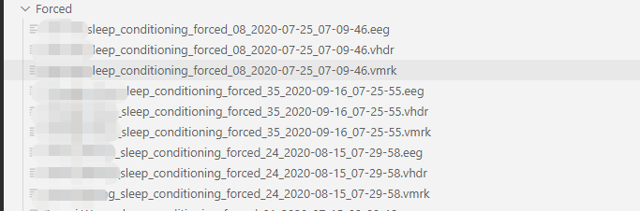
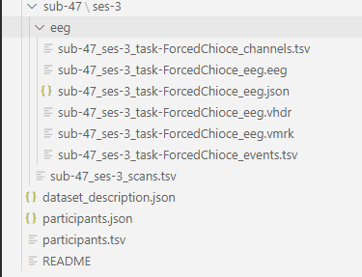
MNE-BIDS

Slide 7
MNE-BIDS - a simple example
>>> import mne
>>> from mne_bids import BIDSPath, write_raw_bids
>>> raw = mne.io.read_raw_fif('my_old_file.fif')
>>> bids_path = BIDSPath(subject='sub_01', session='01’, run='05',datatype='eeg', bids_root='./bids_dataset')
>>> write_raw_bids(raw, bids_path=bids_path)

Slide 8
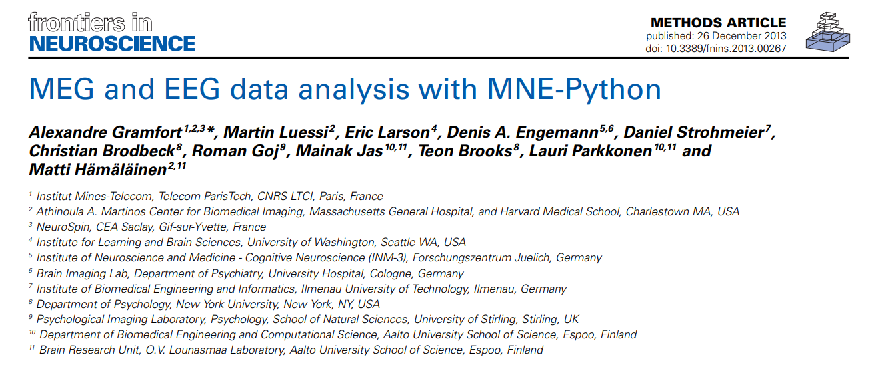

MNE-Python

Slide 9
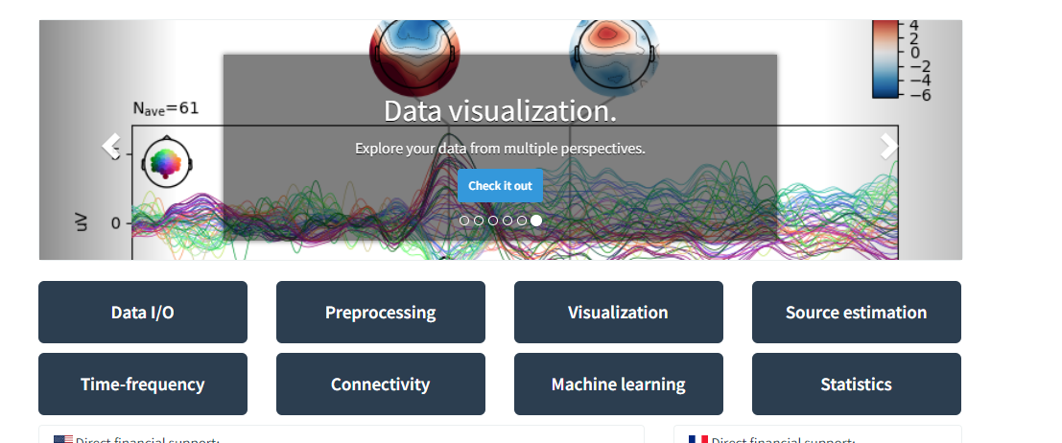
What can MNE-Python do?

Slide 10
Typical EEG workflow in MNE-Python
Raw_data
Epoch_data
Evoked_data
raw=mne.io.read_raw_brainvision(raw_fname+raw_file_list[q],preload=True)
raw.plot(block=True,n_channels=64,duration=30)
raw.set_eeg_reference(ref_channels='average')
montage=mne.channels.make_standard_montage('standard_1020')
raw.set_montage(montage)
raw.filter(l_freq=0.1,h_freq=30,fir_design='firwin')
eog_evoked = create_eog_epochs(raw).average()
ica=ICA(n_components=53,method='fastica').fit(filt_raw, reject_by_annotation=True)
ica.plot_properties(raw)
ica.plot_overlay(raw,picks='eeg')
ica.apply(raw)

Slide 11
Typical EEG workflow in MNE-Python
Raw_data
Epoch_data
Evoked_data
events_id={'Negative':1,'Positive':2}
events,events_id=mne.events_from_annotations(raw,event_id=events_id)
epochs=mne.Epochs(raw,events=new_events,event_id=new_events_id,baseline=(None,0),tmin=-0.2,tmax=0.8)
epochs.plot()
evoked_negative=epochs['Negative'].average()
evoked_positive=epochs['Pegative'].average()
evoked.plot()
freqs=np.arange(1,30,0.5)
n_cycles=np.linspace(2,15,len(freqs))
power1,itc1=tfr_morlet(epochs, freqs=freqs,n_cycles=n_cycles, return_itc=True, average=True)
power1.apply_baseline(baseline=(-1.5,-0.2),mode='zscore')

Slide 12
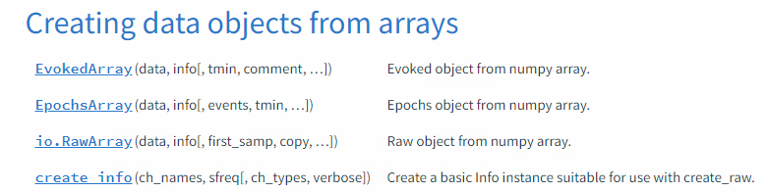
1.How to operate the data?
In [85]: raw.get_data().shape
Out[85]: (64, 264946)
In [86]: epochs.get_data().shape
Out[86]: (144, 64, 501)
In [87]: evoked.data.shape
Out[87]: (64, 501)
raw.crop(tmin=1,tmax=100)
raw.append(raws=[raw1,raw2])

Slide 13
2.How to operate the events?
events,events_id=mne.events_from_annotations(raw,event_id=event_ids)
In [91]: events[0:4]
Out[91]:
array([[10131, 0, 16],
[12251, 0, 9],
[14031, 0, 15],
[15997, 0, 21]])
In [98]: events_id
Out[98]: {'negative': 1, 'positive': 2}

Slide 14
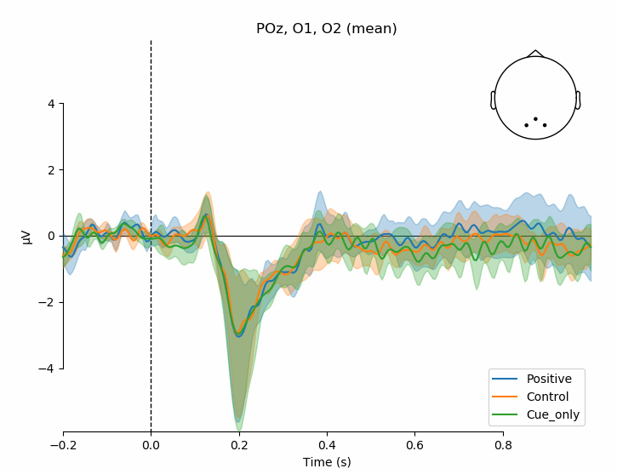
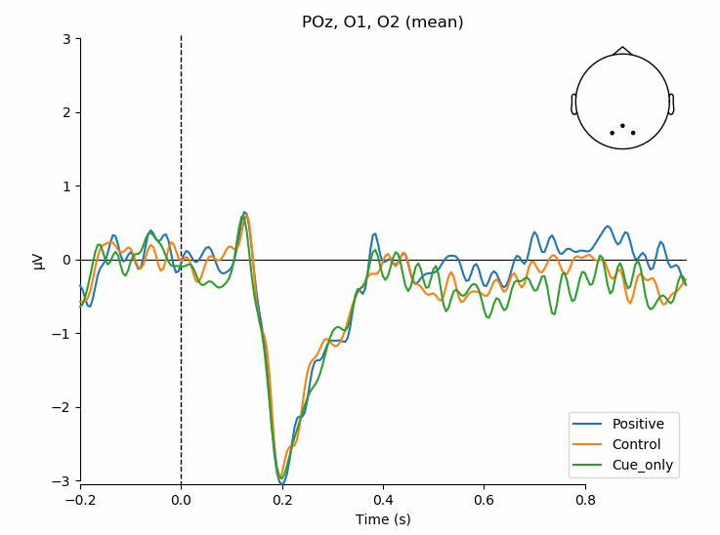
Visualization_ERP
picks=[epochs.ch_names.index(ch)for ch in ['POz','O1','O2']]
condition_index={'Positive':evoked_list1,'Control':evoked_list2,'Cue_only':evoked_list3}
mne.viz.plot_compare_evokeds(condition_index,picks=picks,ci=None,combine='mean',legend='lower right',show_sensors=True)

Slide 15
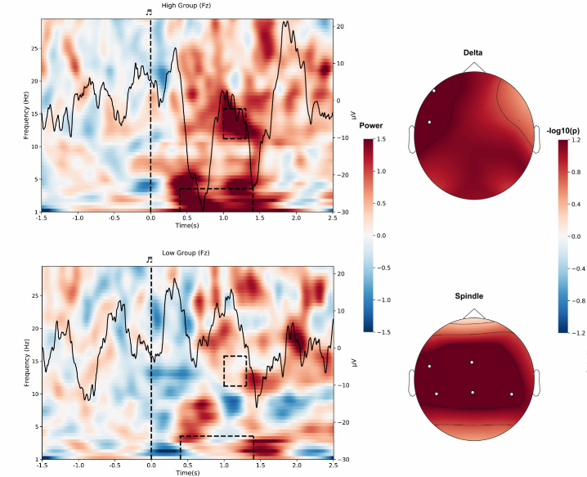
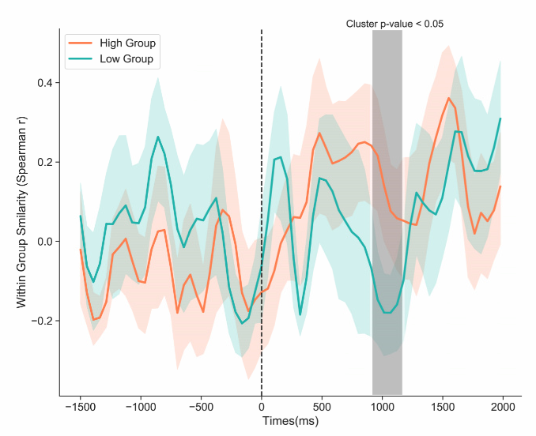
Visualization_TF

Slide 16
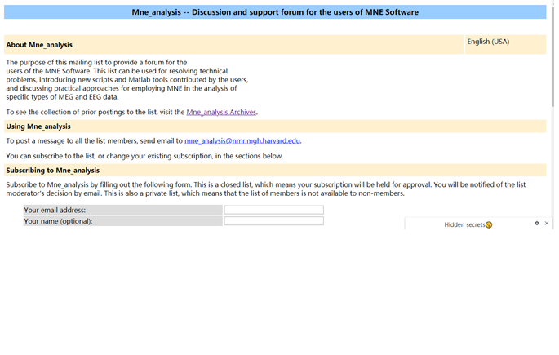

How to fix the error?

Slide 17
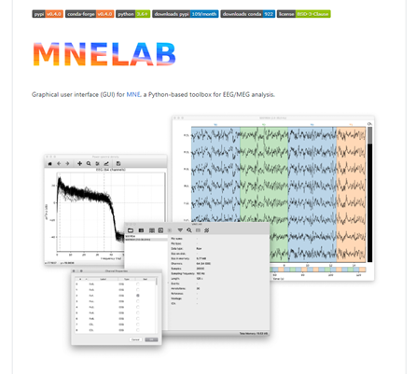
MNE-Python GUI

Slide 18
Let’s do it.

Slide 19



Thanks
https://www.psychology.hku.hk/scnlab

